Slide 1
Ansible & Docker
Tran Van Dong 20203363

Slide 2
Ansible
Ansible is an IT automation tool to configure systems, deploy software, and orchestrate more advanced IT tasks (continuous deployments or zero downtime rolling updates).
Ansible’s main goals are simplicity and ease-of-use. It also has a strong focus on security and reliability, featuring a minimum of moving parts, usage of OpenSSH for transport.
Ansible manages machines in an agent-less manner (doesn’t require the installation of any extra agents on the managed nodes)
Ansible is decentralized–it relies on your existing OS credentials to control access to remote machines.

Slide 3
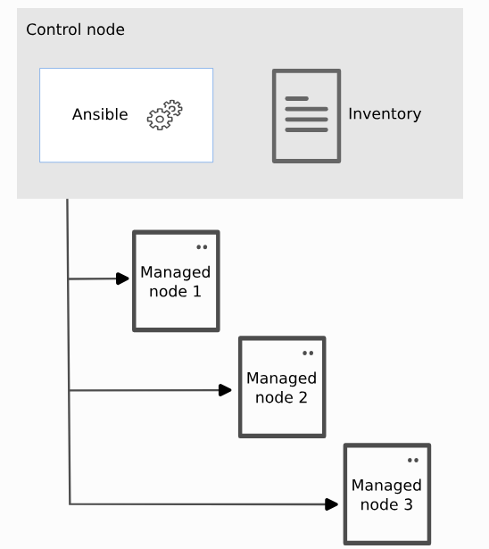
Ansible Architecture
Ansible automates the management of remote systems and controls their desired state.
A basic Ansible environment has three main components:
Control node: A system on which Ansible is installed.
Managed node: A remote system, or host, that Ansible controls.
Inventory: A list of managed nodes that are logically organized.

Slide 4
Inventory file
Inventory: A collection of all the hosts and groups that Ansible manages.
Inventories organize managed nodes in centralized files that provide Ansible with system information and network locations.
By using an inventory file, Ansible can manage a large number of hosts with a single command.
Default inventory file: /etc/ansible/hosts.
Inventory files can be in INI or YAML format.

Slide 5
Ansible concepts
Playbook: contain Plays (which are the basic unit of Ansible execution), written in YAML and are easy to read, write, share and understand.
Plays: maps managed nodes (hosts) to tasks, contains variables, roles and an ordered lists of tasks and can be run repeatedly.
Roles: A limited distribution of reusable Ansible content (tasks, plugins,...) for use inside of a Play.
Tasks: an ‘action’ to be applied to the managed host, and must always be contained in a Play.
Handlers: special form of a task, only executes when a previous task resulted in a "changed" status
Notes:
To use any Role resource, the Role itself must be imported into the Play.

Slide 6
Ansible concepts
Modules: the code or binaries that Ansible copies to and executes on each managed node (when needed) to accomplish the action defined in each Task.
Each module has particular use.
You can invoke a single module with a task, or invoke several different modules in a playbook.

Slide 7
Ansible concepts
Plugins: Pieces of code that expand Ansible’s core capabilities. They can control how you:
connect to a managed node (connection plugins)
manipulate data (filter plugins)
even control what is played in the console (callback plugins)

Slide 8
How does Ansible work?
Ansible uses the concepts of control and managed nodes.
The control node, any machine with Ansible installed, connects and sends commands and instructions to the managed nodes:
The units of code that Ansible executes on the managed nodes are called modules.
Each module is invoked by a task.
⇒ An ordered list of tasks together forms a playbook.
Users write playbooks with tasks and modules to define the desired state of the system.

Slide 10
Docker
Docker is a tool that allows users to easily deploy their applications in a sandbox (called containers) to run on the host operating system.
The key benefit of Docker is that it allows users to package an application with all of its dependencies into a standardized unit for software development.

Slide 11
What is container?
A container:
Is a runnable instance of an image. You can create, start, stop, move, or delete a container using the DockerAPI or CLI.
Can be run on local machines, virtual machines or deployed to the cloud
Is portable (can be run on any OS)
Is isolated from other containers and runs its own software, binaries, and configurations.

Slide 12
What is a container image?
Container image contains the container’s filesystem – everything needed to run an application – all dependencies, configurations, scripts, binaries,…
It also contains other configuration for the container, such as environment variables, a default command to run, and other metadata.

Slide 13
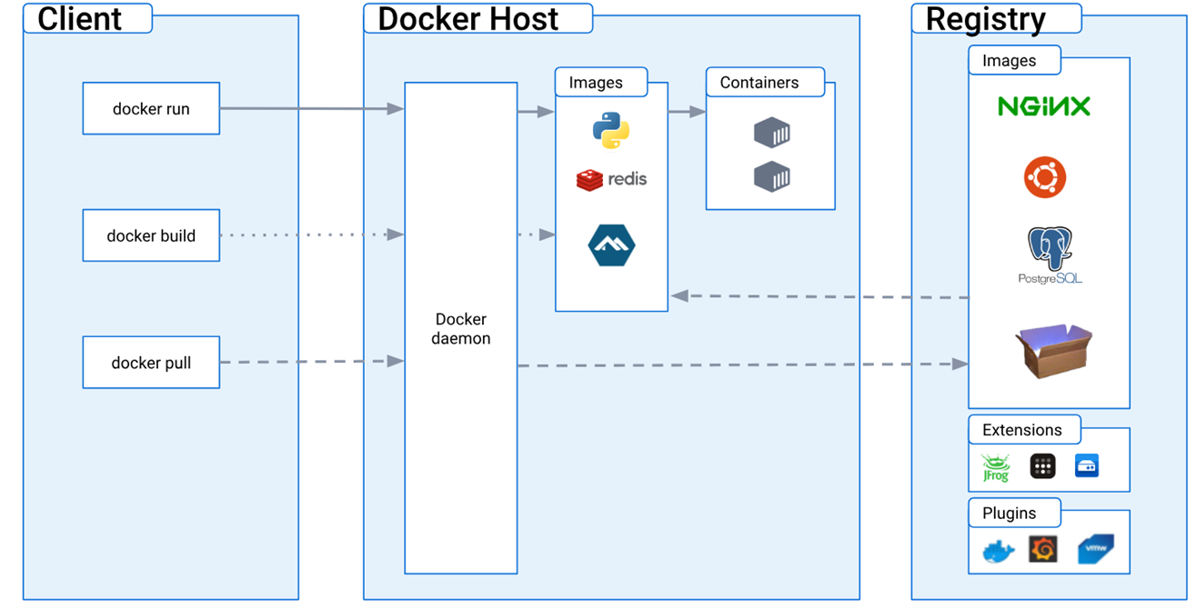
Docker Architecture
Docker uses a client-server architecture.
REST API, UNIX sockets, or a network interface

